Slide 1
Aerobridge Database GUI User Manual
Vinu Karthek
5th January 2016

Slide 2
Result Comparison

Slide 3
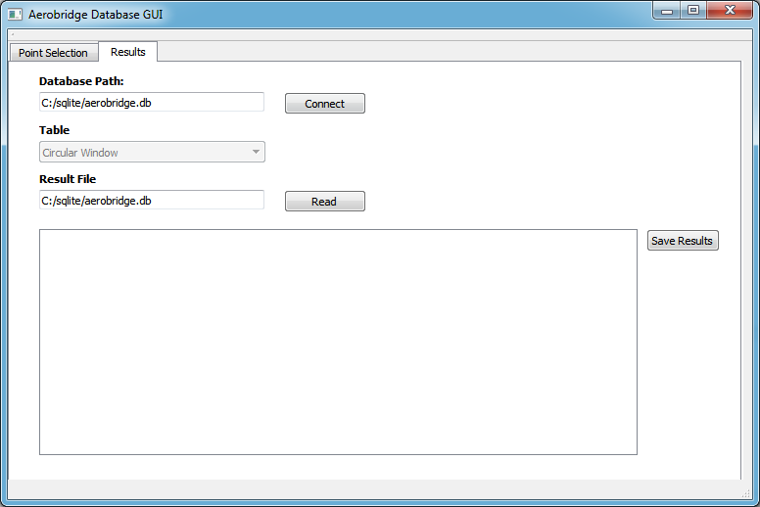
Select “Results” Tab & Double Click On “Database Path”:

Slide 4
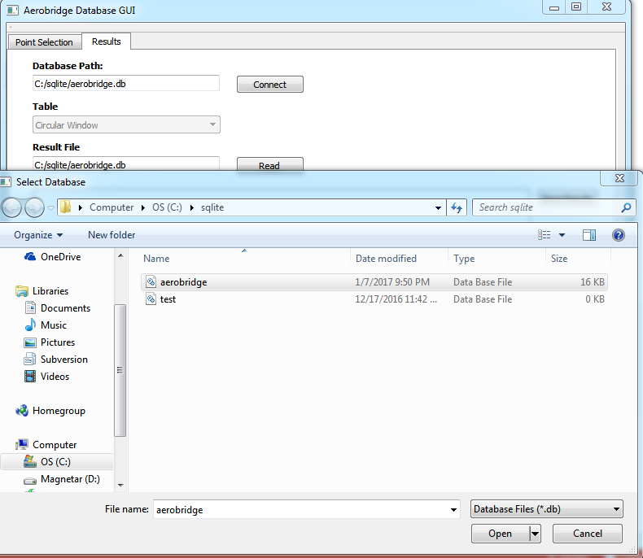
Browse for aerobridge.DB & Select “Open”

Slide 5
Click “Connect”

Slide 6
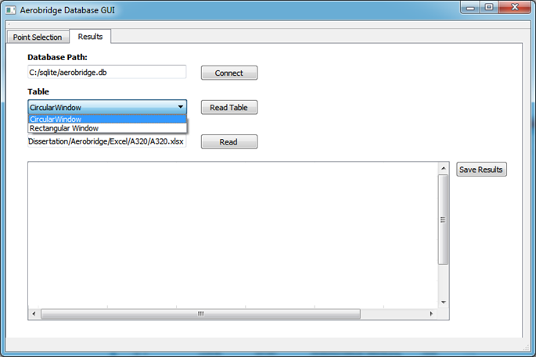
Select “Table”

Slide 7
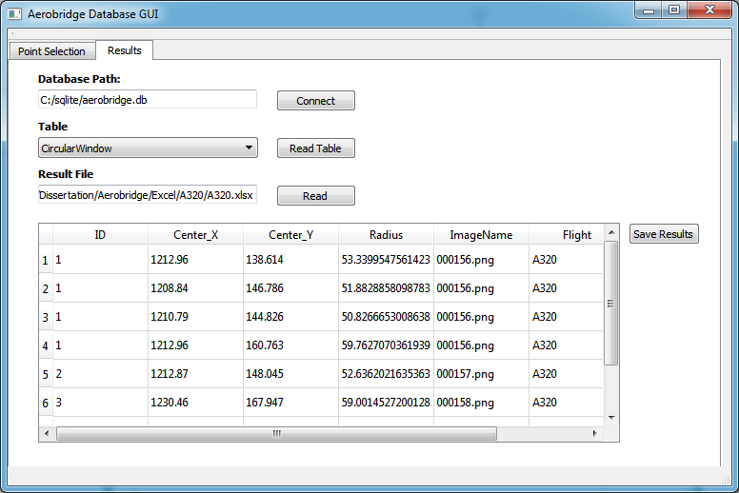
Click “Read Table”, Shows DB Data

Slide 8
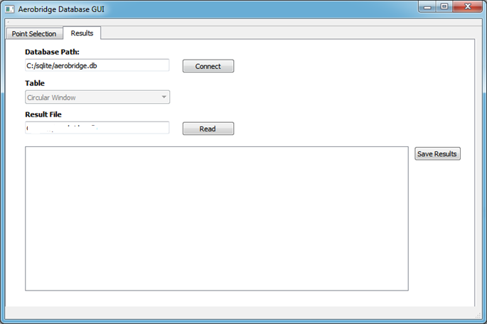
Double Click On “Result File”:

Slide 9
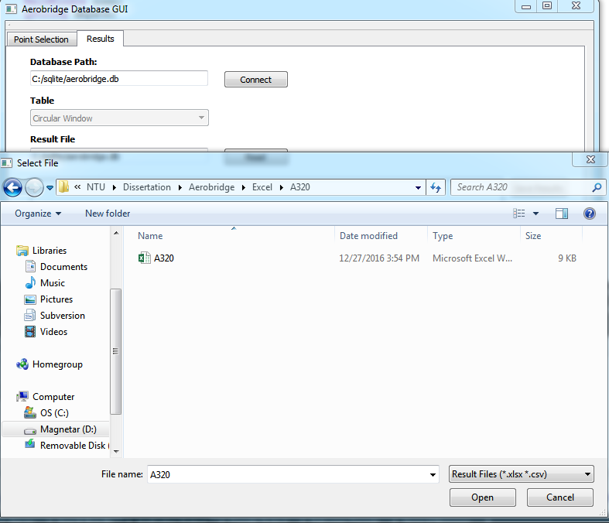
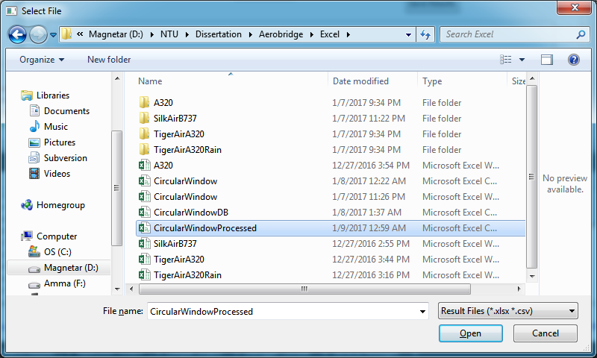
Browse for Detection Result File & Select “Open”

Slide 10
Click “Read”, Shows File Data

Slide 11
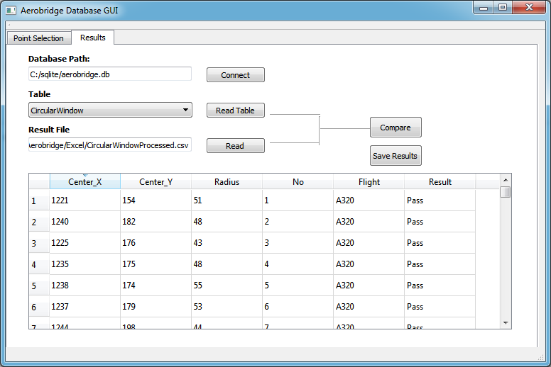
Click “Compare”:

Slide 12
Image Point Selection

Slide 13
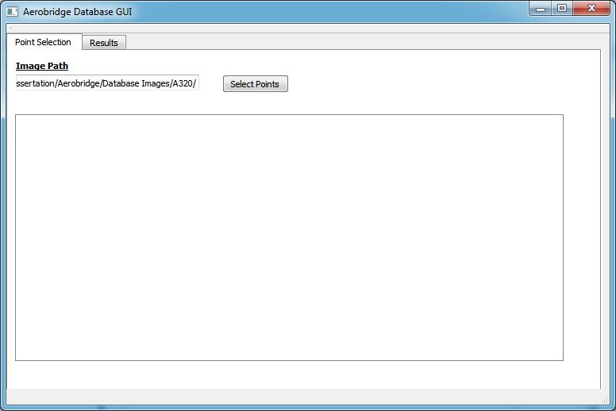
Select “Point Selection” Tab & Double Click On “Select Points”:

Slide 14
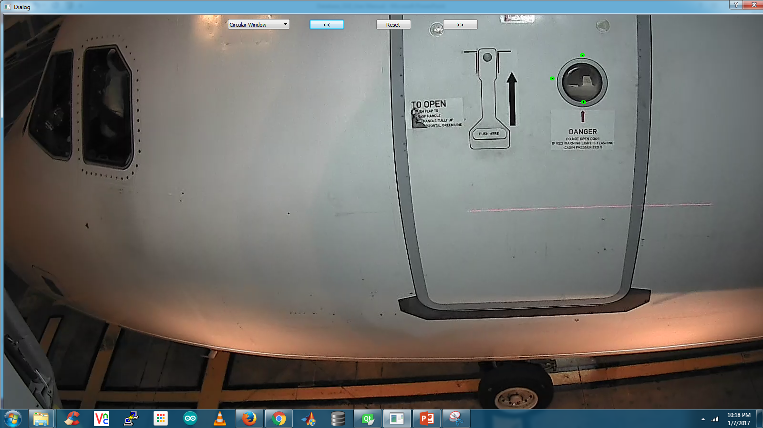
Select Points On Image(in Green) & Click “>>” Saves Points To DB:
Select Feature
Resets Points
Previous Img
Next Img

